Slide 1


The world answered the call in 2018, and we made a difference…
…in 2019, we have a chance to change the world together…
https://callforcode.org
Accept the challenge: ibm.biz/c4csingapore

Slide 2
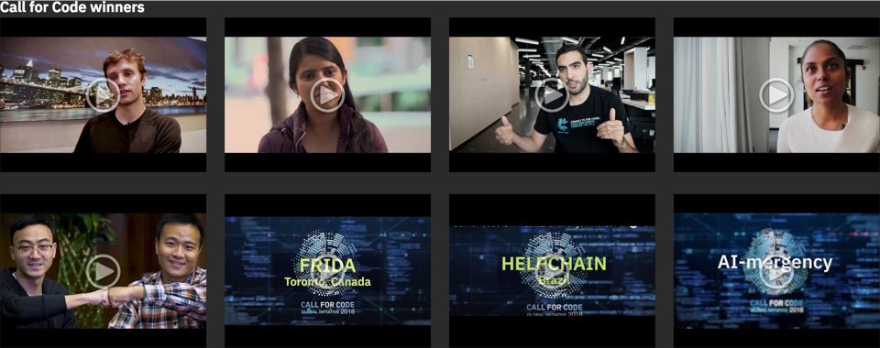
The heart of a coder is grounded in becoming a problem solver, a creator, and an innovator…
2018 Highlights: A global success
100k+
Developers participated in 2018
2,500+
Applications created
400+
Call for Code days across the world
7,100
Total award event livestream views
40+
Celebrity supporters
callforcode.org

